Slide 1
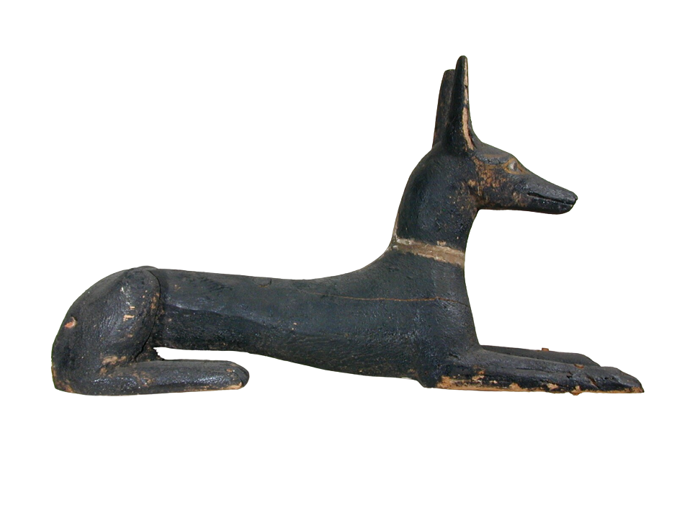
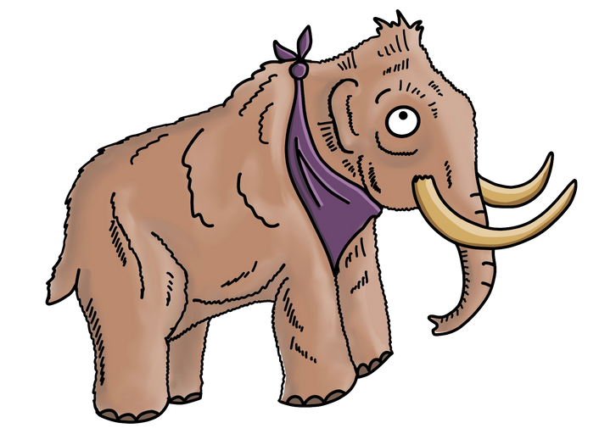
top ten
Treasures
of the
Ancient Egyptians
Star objects at
Ipswich Museum

Slide 2

Critical Eye
This contains ideas, thoughts and questions to help you better understand each object.

Slide 3
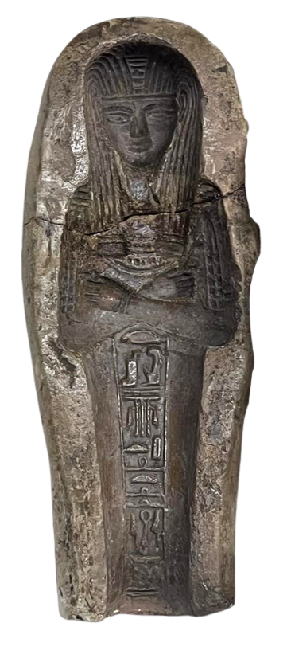
Wonders Gallery
Shabti Mould
1570-1069 BCE
New Kingdom
A shabti is a small statue in the form of a mummified person, inscribed with a spell to make it come alive in the afterlife. Here, the ‘magical servant’ would do all the jobs for the dead.
They were very popular in the New Kingdom, and later it became important to have as many as possible in your tomb. This mould was used to make lots of clay shabtis more quickly.
IPSMG:CSA.2009.75

Slide 4
Critical Eye
Skilled makers used moulds to produce shabtis more quickly.
This meant that more people could feel reassured that they would have support from shabtis in the afterlife.

Slide 5
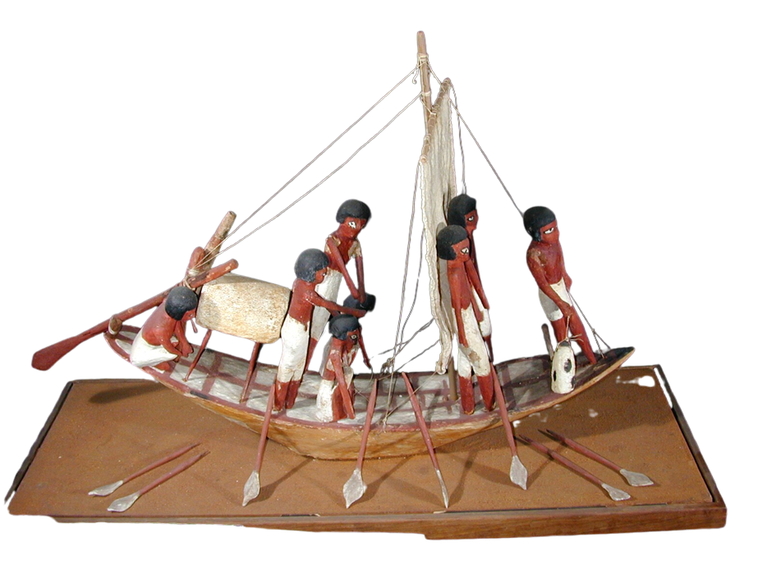
Journeys Gallery
Sailing Boat Model
2160-2040 BCE
The crew are ready to take the soul of the dead along the river Nile: upstream, to the house of Osiris at Abydos in the south of Egypt, using the oars; and returning home downstream using the sail.
9th Dynasty
This model came from the desert burial ground at Sedment.
The model would have been sealed in a
tomb. It represents the beliefs about the afterlife at this time - that the soul of the dead must make a journey to meet Osris, the God of the Dead.
IPSMG:R.1921.89.65

Slide 6
Critical Eye
The River Nile remains an important transport route through modern Egypt.
Having once carried souls to
the afterlife, this boat is
now far from home.
What journey did it
make to arrive
in Ipswich?

Slide 7
Anubis Sculpture
Journeys Gallery
664-332 BCE
Late Period
Anubis (or Anpu) was the jackal-headed god
of mummification and a guide to the underworld.
This wooden sculpture is painted black as a sign of rebirth, and Anubis is shown as a full animal - a watchdog in the tomb; alert and ready to keep the soul safe from harm.
Dogs and jackals often patrolled the desert cemeteries, so were thought of as protectors of the dead.
IPSMG:R.1921.89.58

Slide 8
Critical Eye
Much more than a beautiful decoration, this figure is sacred and linked with protection and justice.
Anubis is a watchdog for the dead, but who does he protect now, in Ipswich?

Slide 9
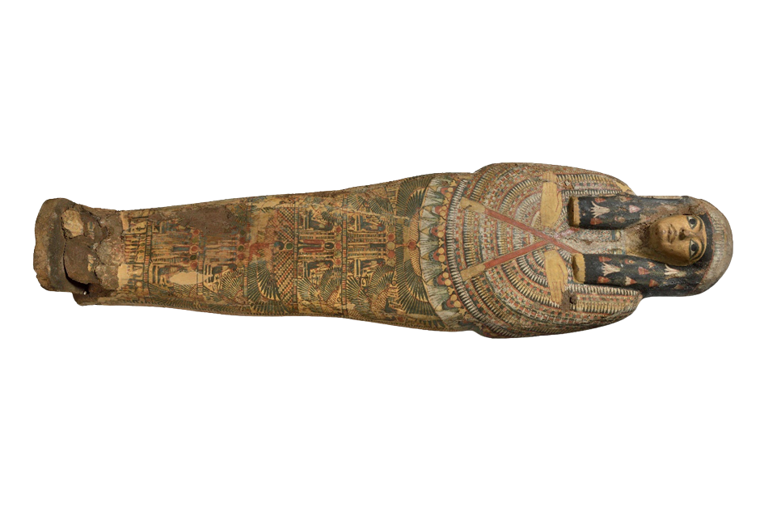
Journeys Gallery
Painted Coffin
Late 21st Dynasty
1077-943 BCE
This coffin is in the shape of a mummified person so that the soul has a protected body for the afterlife.
This is probably from ancient Thebes (modern Luxor), but we don’t know the name of the woman it belonged to.
It is richly decorated with spells, pictures of gods, and a garland of flowers in her hair. The red lines represent the straps used to keep the bandages in place during mummification during this time period.
IPSMG:R.1953.33

Slide 10
Critical Eye
This was made to protect the soul of a woman who died about 3000 years ago.
Today it no longer holds her body and is far from Egypt. What does this separation mean for her hopes of an afterlife?

Slide 11
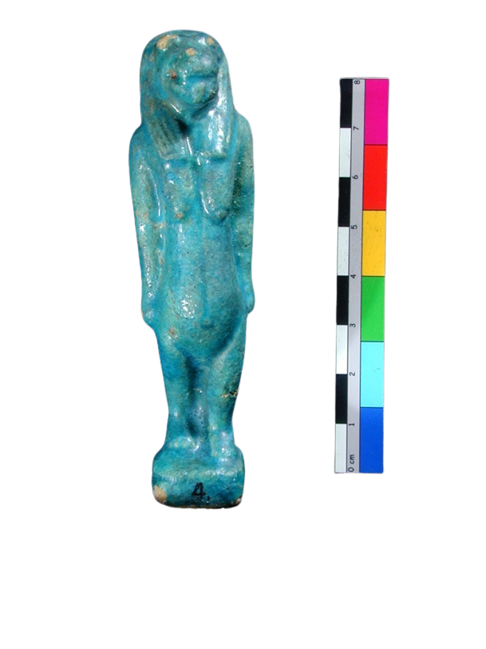
Taweret Figure
Create Gallery
1070-332 BCE
3rd Intermediate to Late Period
Taweret (or Opet) was a goddess with the body of a pregnant hippopotamus, the legs of a lioness, the back and tail of a crocodile, and the hair of a woman.
People would have seen how fiercely protective hippos were of their babies, so this was the goddess of pregnant women, new mothers and children.
She would have been worshipped at home rather than in a temple.
IPSMG:R.1920.80.4

Slide 12
Critical Eye
Taweret stands guard in a museum case, far from her original home, watching over those who pass by.
Can she still comfort and protect the mothers and children who come to see her today?

Slide 13
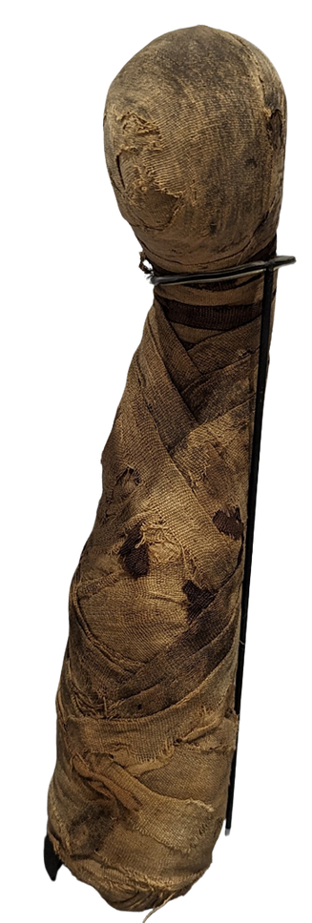
Discoveries Gallery
Mummified Cat
664-332 BCE
Late Period
Cats were sacred animals associated with the cat-goddess called Bast. She was responsible for health, protection, fertility and the home.
Mummified cats were offered to Bast as religious gifts in such great numbers that entire cat graveyards have been discovered.
IPSMG:R.1932.28.1
They were also placed in tombs to protect the soul of the dead on the journey to the the afterlife.
Our mummified cat is very small so is probably a kitten.

Slide 14
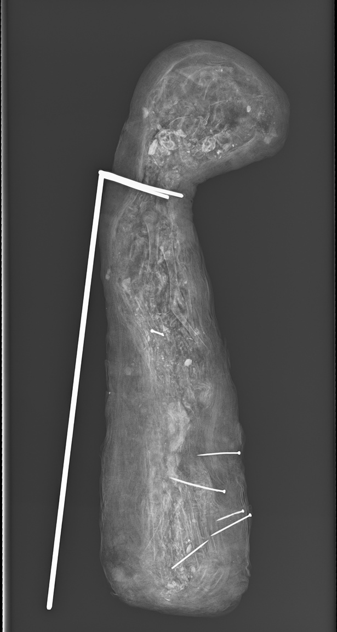
Critical Eye
How do we know if there is actually a cat underneath the bandages?
We have an X-ray image that shows inside!
This animal was for a sacred purpose. Do you think it would be OK to unwrap it?

Slide 15
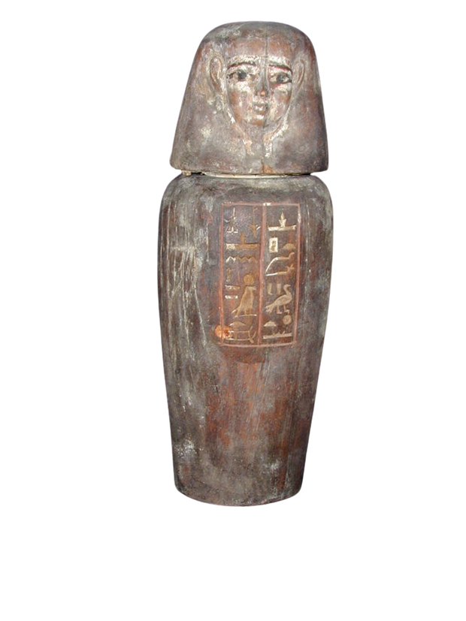
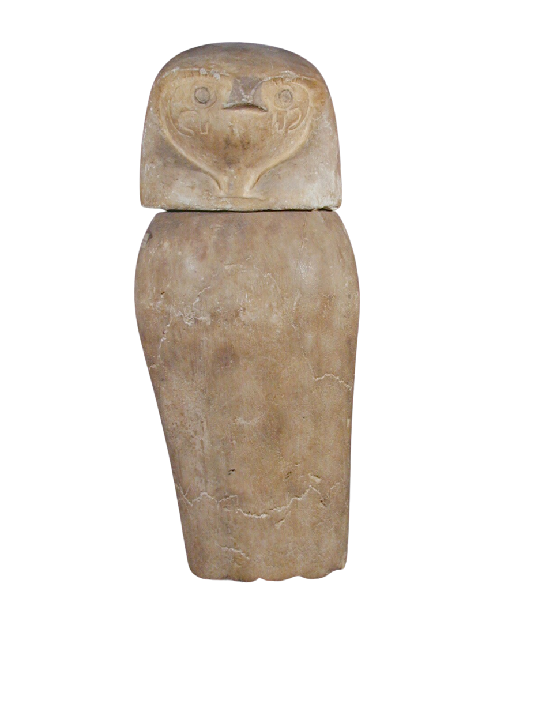
Funerary Jars
Communities Gallery
2055-1069 BCE
Middle/New Kingdoms
These jars held the organs of a mummified person for protection, as a whole body was needed to become god-like in the afterlife.
The lids are modelled on the sons of the god Horus.
Here we have a wooden Imseti jar, with a human head, for the liver, and a limestone Qebesenuf jar, with the head of a hawk, for the intestines.
IPSMG:R.1944.44.29
IPSMG:R.1931.79
The lungs were looked after by Hapi, with the head of a baboon, and Duamutef, the jackal-headed god, held the stomach.

Slide 16
Critical Eye
Death was seen, not as an end, but as a transformation into eternal life. Preserving the body, the soul, and the name was important for this process.
These jars allowed the body to remain whole, both physically and spiritually.
So, what does it mean now that the organs are no longer in these jars?

Slide 17
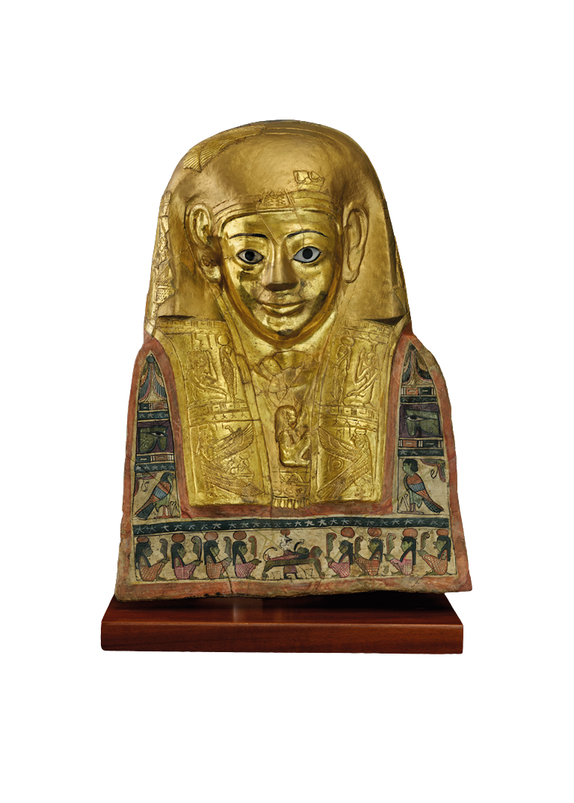
Golden Mask
Communities Gallery
110 CE
Roman Period
This mask is made of cartonnage: canvas, papyrus and plaster. It was moulded to the person’s face after mummification, then painted and decorated with gold leaf.
Gold represents the skin of the gods, and the hope to be transformed into a divine being in the afterlife.
This mask, from Hawara, was for a man called Titus Flavius Demetrios - a Roman citizen living in Egypt. Even long after the rule of the Pharaohs, Ancient Egyptian religious rituals continued.
IPSMG:R.1992.89.2

Slide 18
Critical Eye
This mask was an idealised version of the person. It helped the living to remember the dead.
Being remembered was important to keep their spirit alive.
These ideas have continued across time and cultures.
How do we keep the memory of someone alive today?

Slide 19
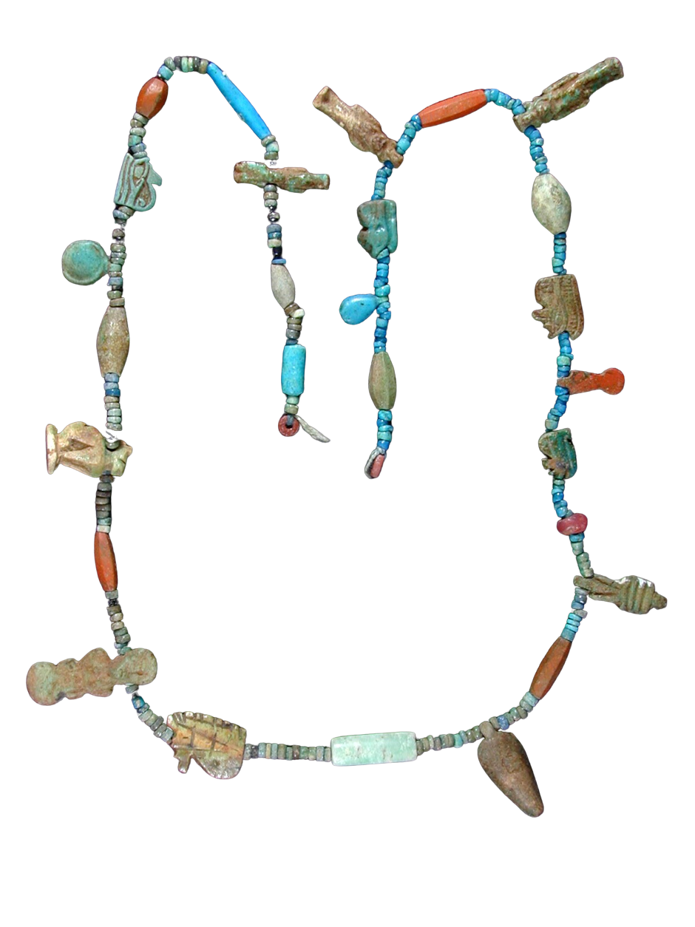
Bead Necklace
Communities Gallery
1292-1189 BCE
19th Dynasty
This beautiful set of beads from Thebes (now Luxor) contains small amulets such as the Eye of Horus (or Wedjat) for protection, and the Djed pillar for stability. What else can you see?
The tiniest beads are made of clay, the red beads are polished jasper, and the amulet shapes are made from a glazed paste called ‘faience’ (something between clay and glass).
IPSMG:R.1920.80.16

Slide 20
Critical Eye
These beads are sacred and spiritual. They were placed on the body of a mummified person for protection in the afterlife.
Think about who might have worn this jewellery – in life or in death.
And how do you feel about displaying something that was once part of a sacred burial?

Slide 21
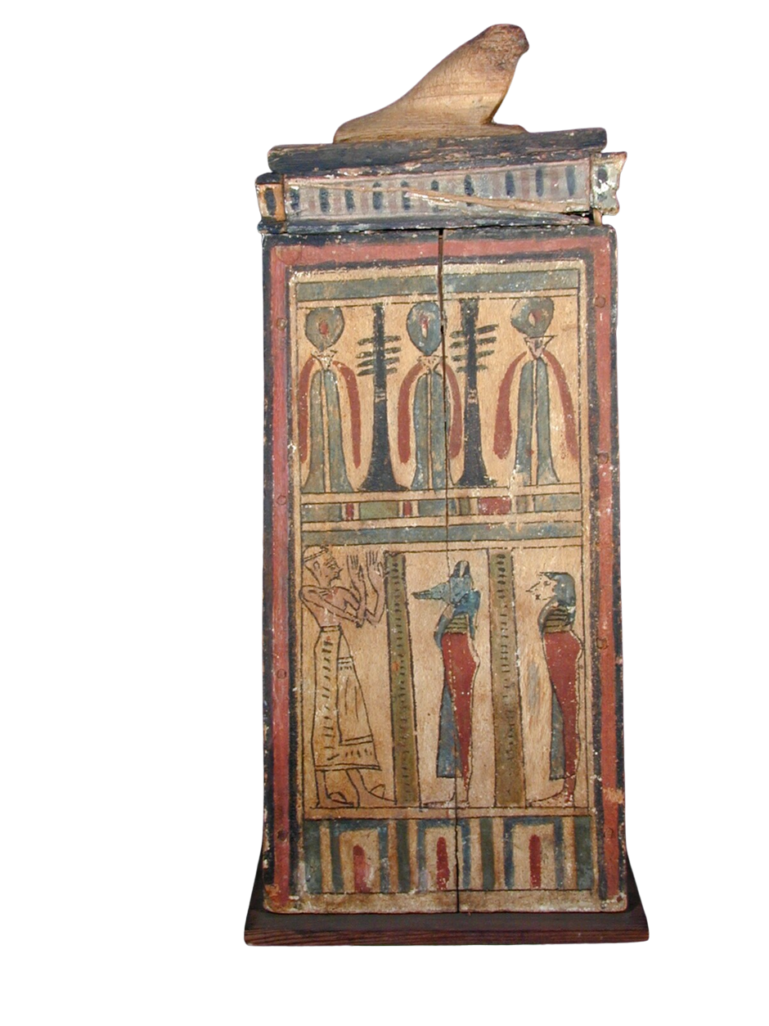
Shabti Box
Communities Gallery
332 BCE-395 CE
Ptolemaic to Roman Period
Found in a tomb, this painted box contained a set of shabtis, or magical servants.
They would spring to life and do jobs for you, like growing crops and tending to animals, in the Field of Reeds - a paradise in the afterlife.
Among the decorations we can see Anubis, the jackal-headed god of mummification, while on top rests the hawk-god Horus, providing protection.
IPSMG:R.1932.27.3

Slide 22
Critical Eye
This box was carefully made, not to be seen, but as part of a sacred resting place in a tomb.
How do you think the person it belonged to would feel about it being here in Ipswich – its little workers left with no job to carry out?

Slide 23














Craft
Which is your favourite?
Why do you like it?
If the object could talk, what questions would you ask it?
Write
Think
Discuss
Draw
Call Us
Visit Our Website
Our Location
+123-456-7890
www.reallygreatsite.com
123 Anywhere St., Any City

