Slide 1
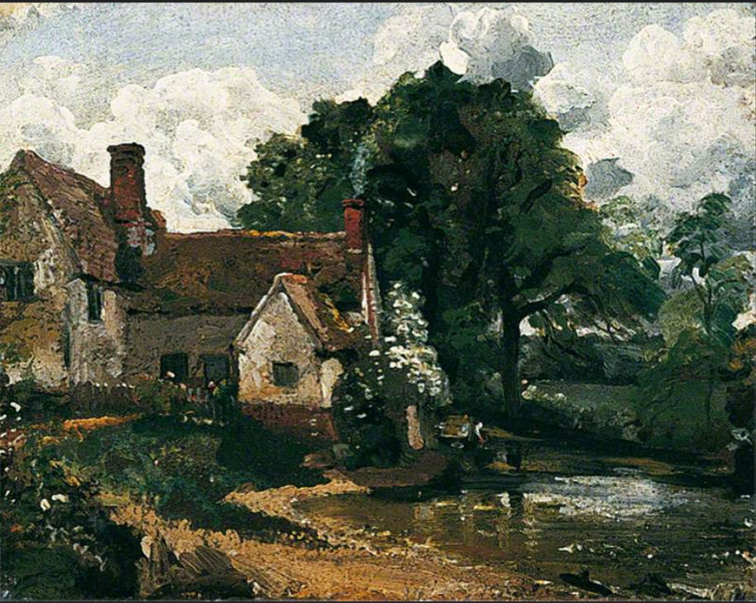








Landscape Image Bank
+123-456-7890
www.reallygreatsite.com

Slide 2
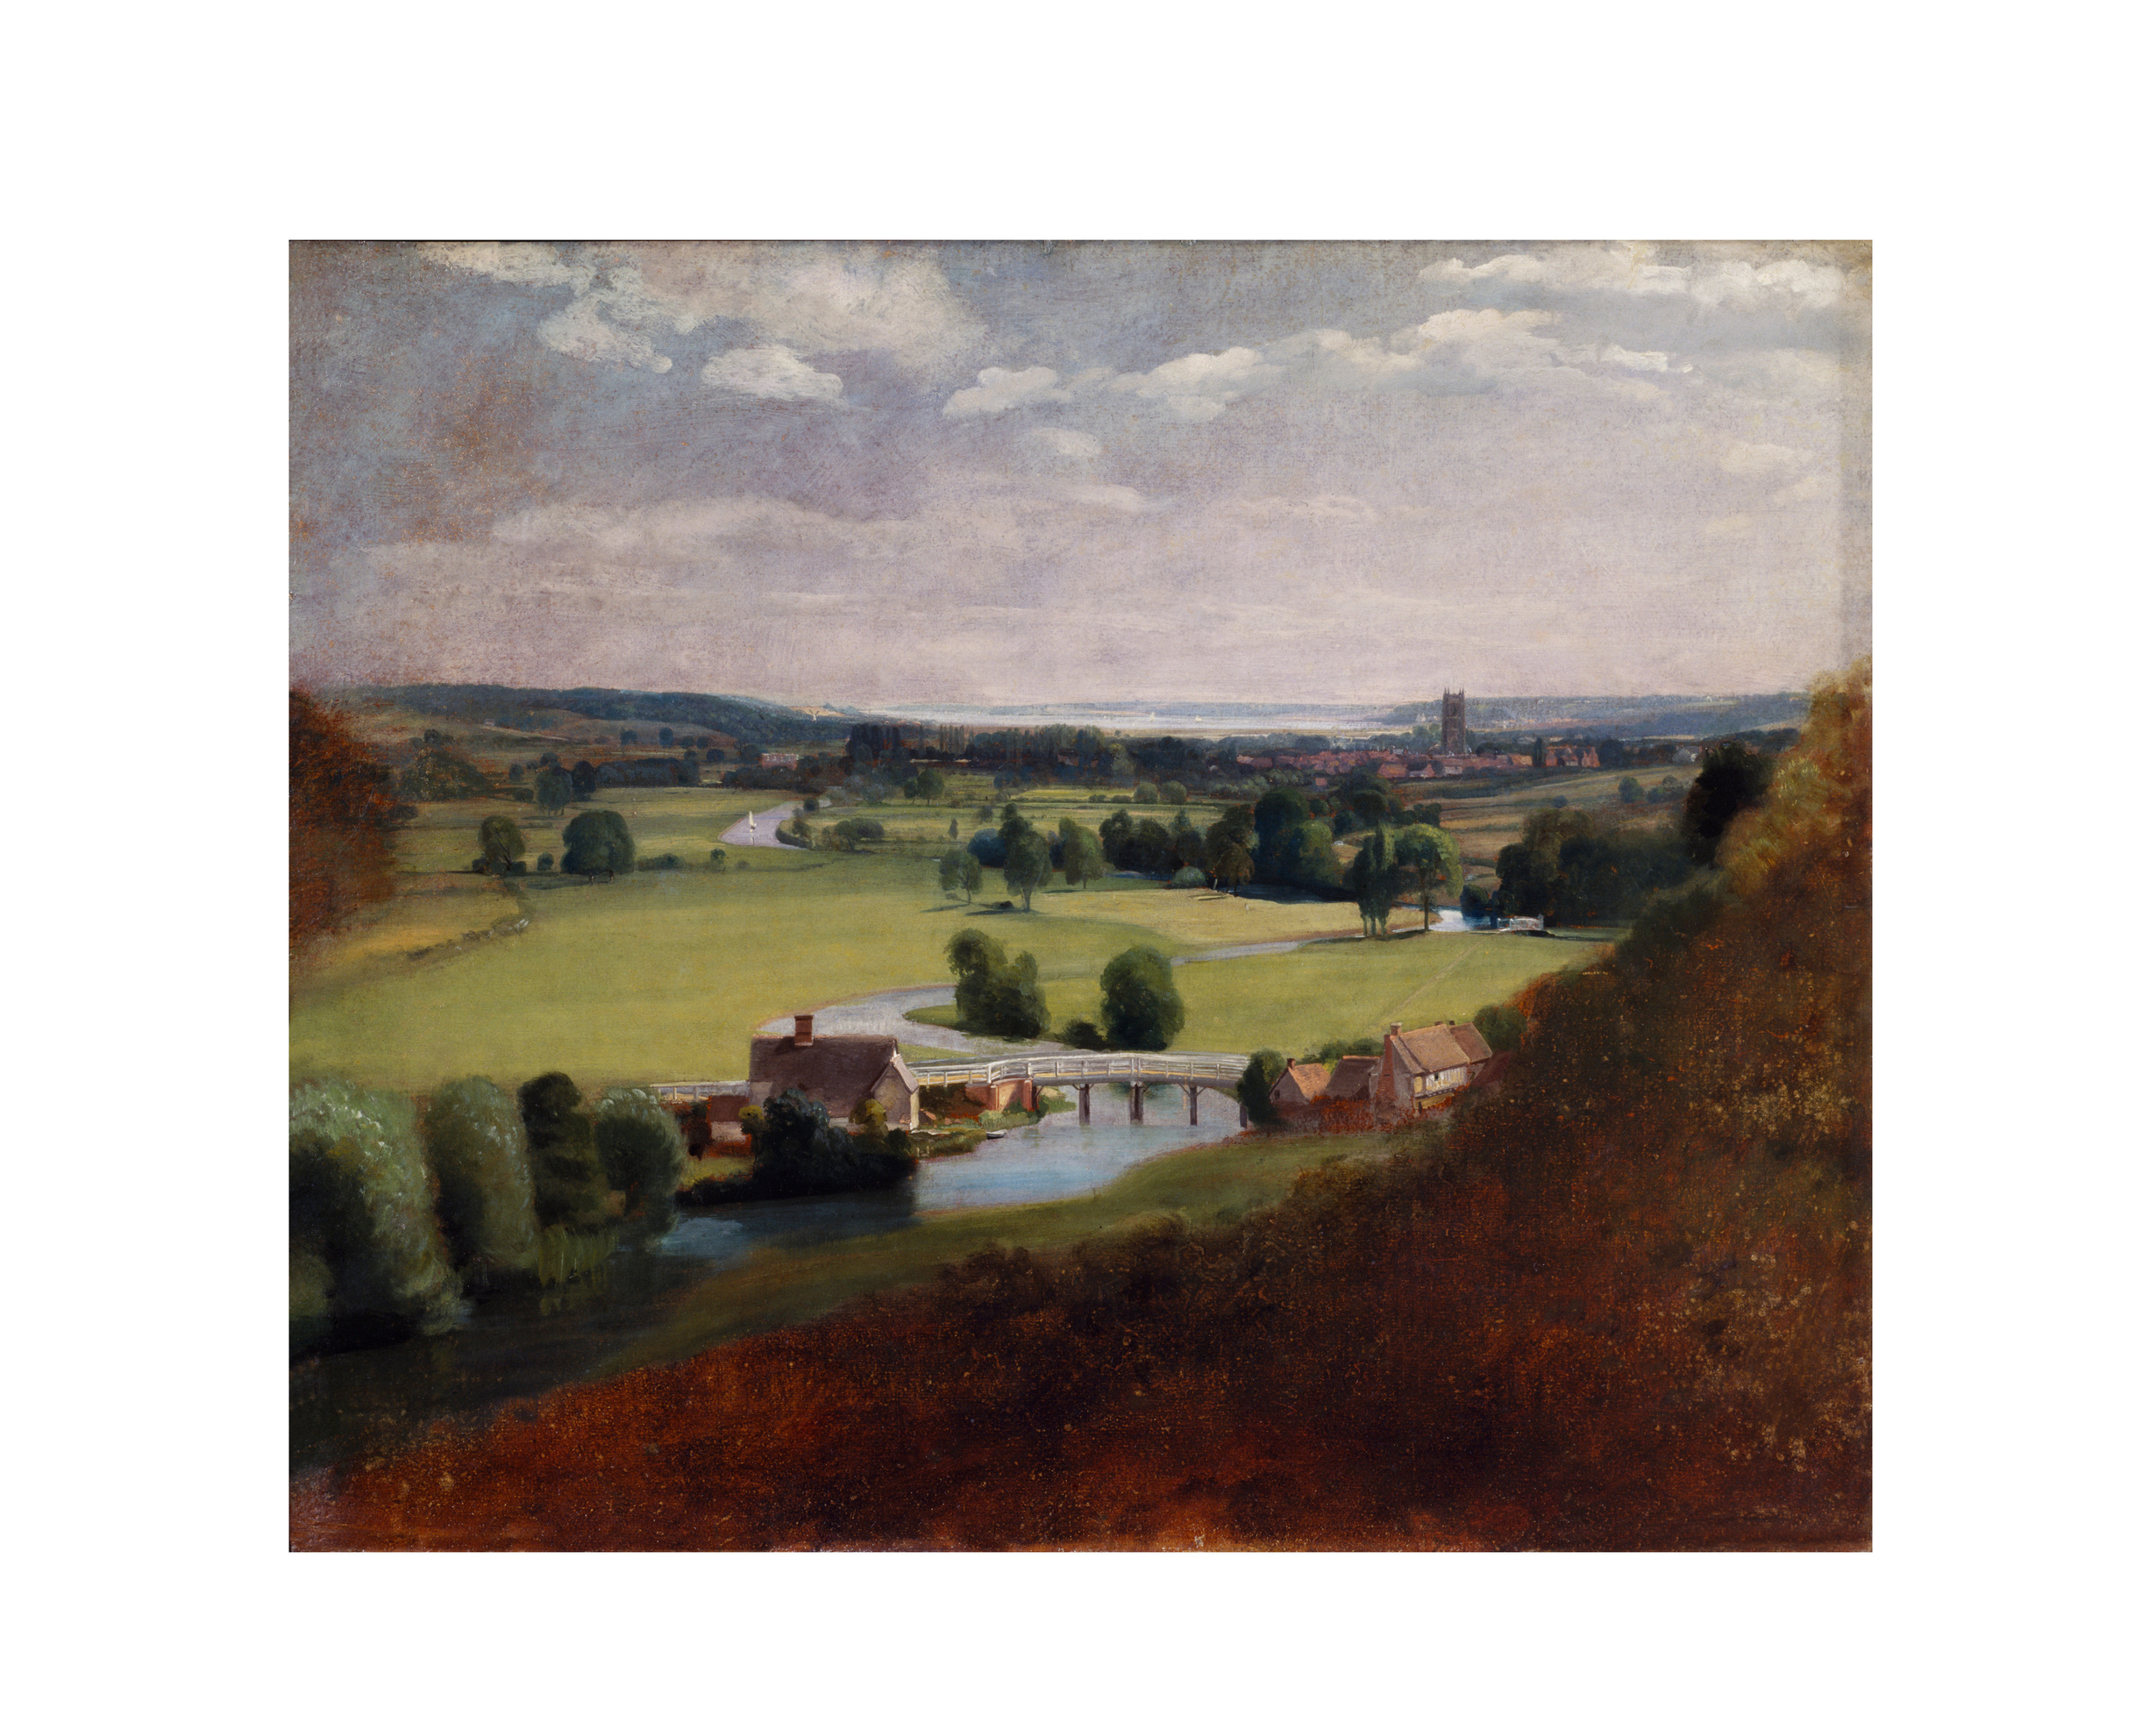
The Valley of the Stour with Dedham in the Distance, about 1800
John Constable (1776–1837)
© Victoria and Albert Museum, London
Oil on paper laid on canvas
H 49.8 x W 60 cm

Slide 3
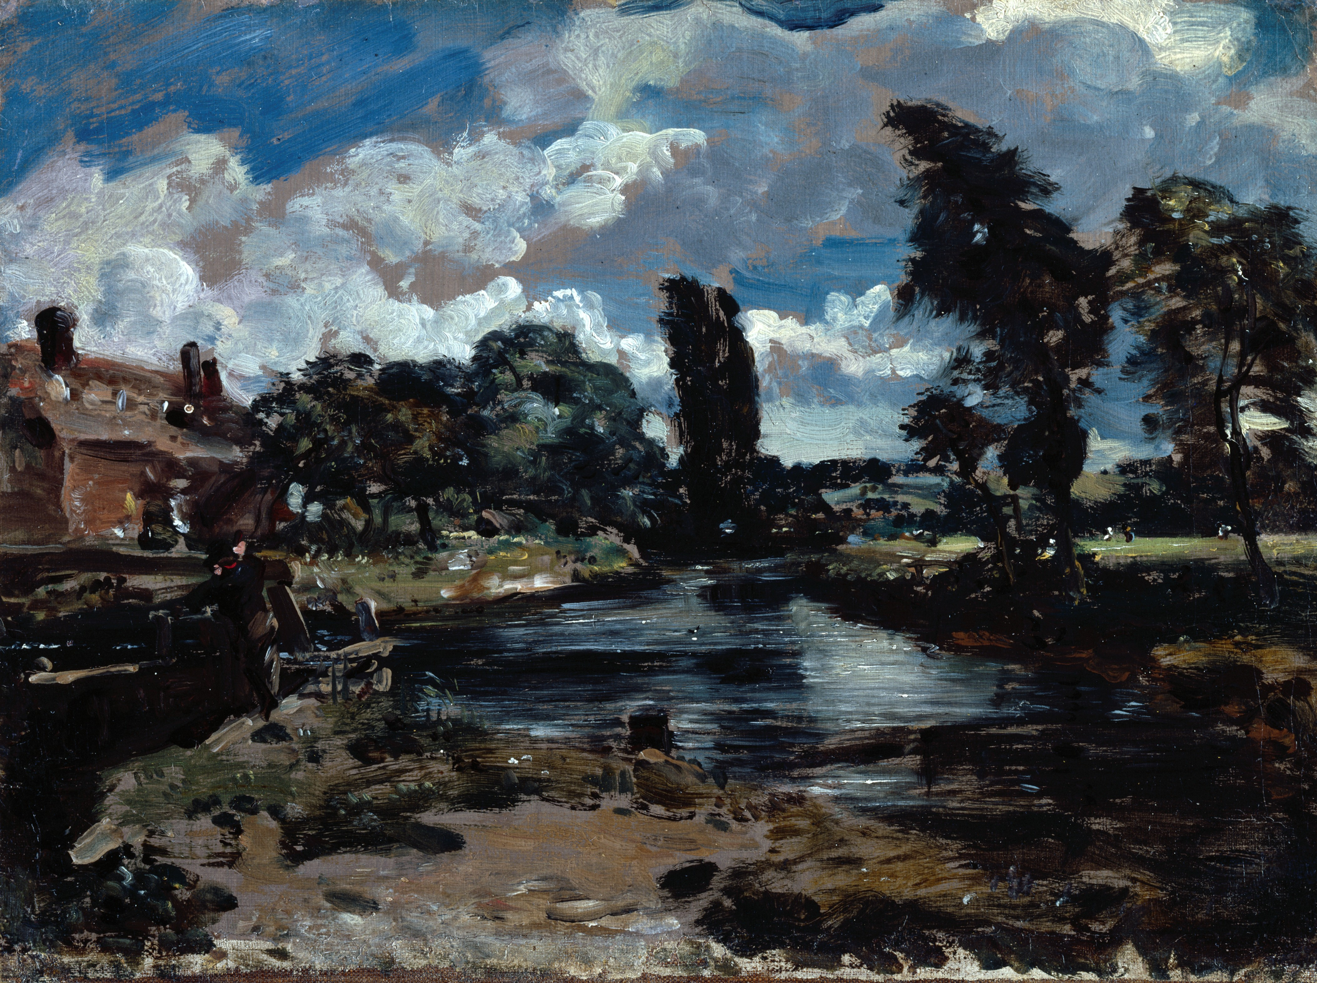
Flatford Mill from a Lock on the Stour, about 1811
John Constable (1776–1837)
© Photo: Royal Academy of Arts, London
Photographer: John Hammond
Oil on paper laid on canvas
H 26 x W 35.5 cm

Slide 4
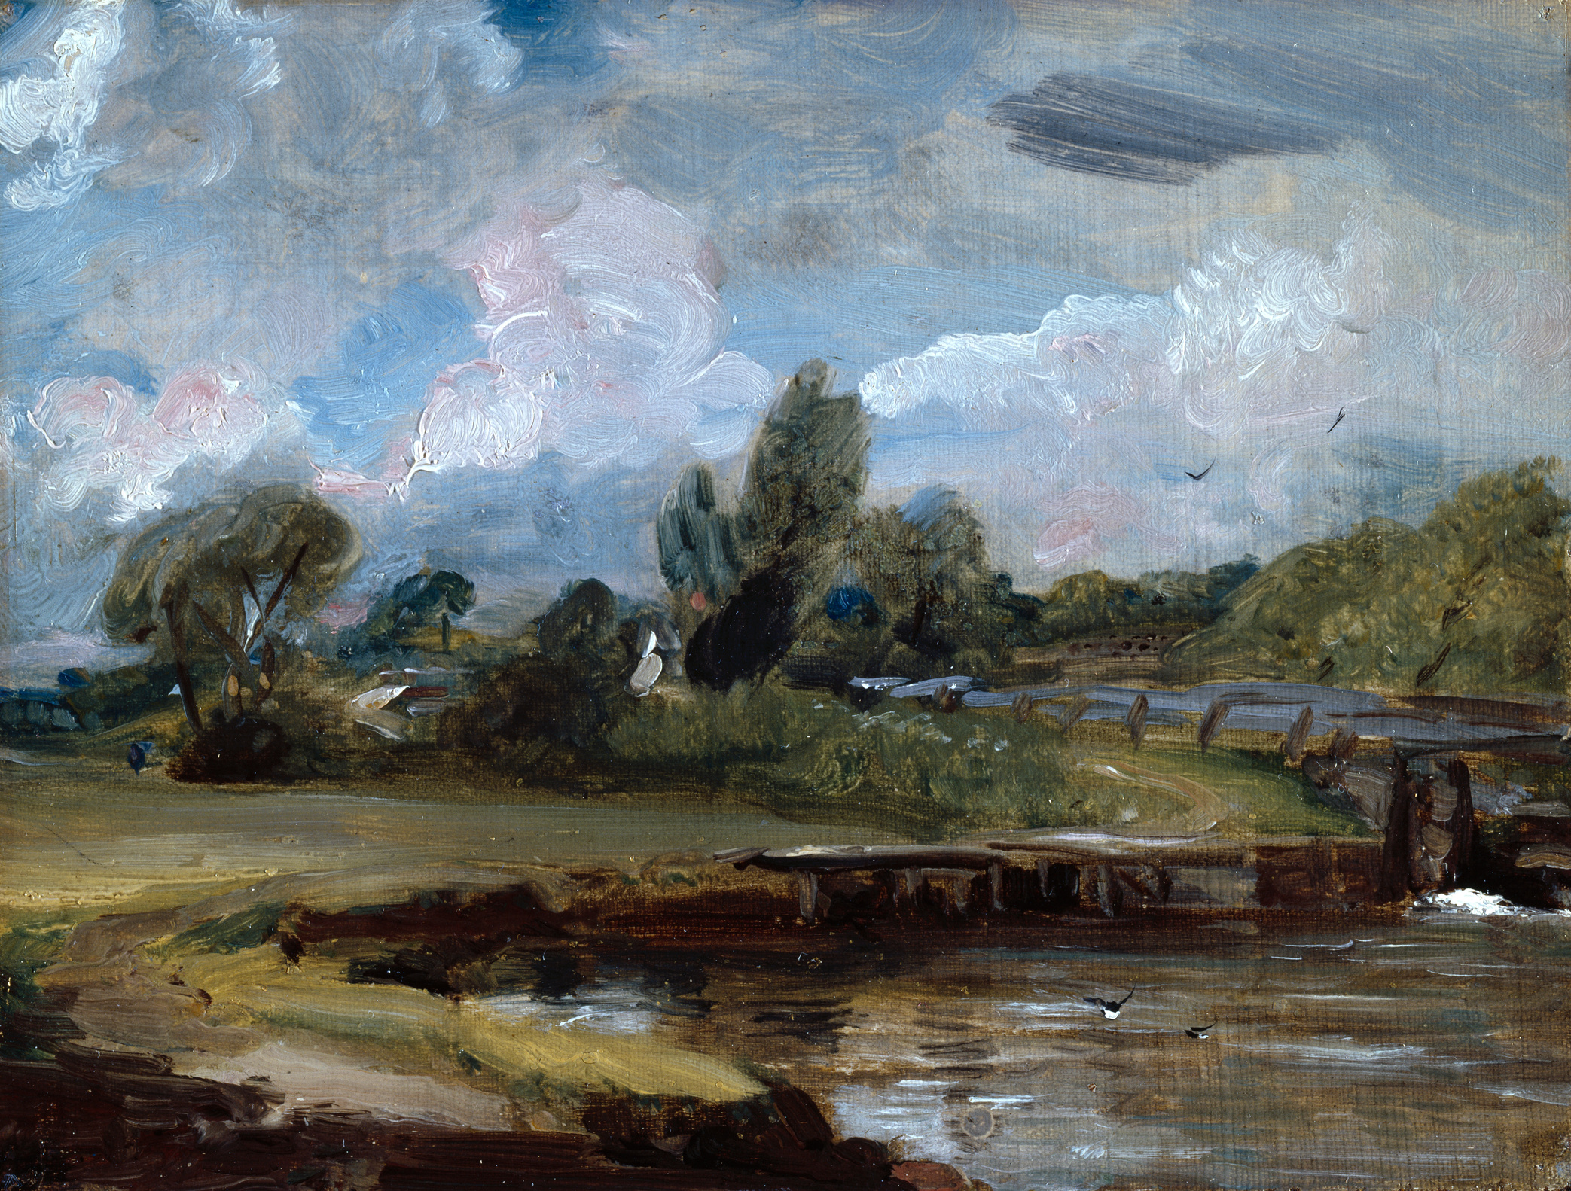
Flatford Lock, A Path by a River, about 1810-1812
John Constable (1776–1837)
© Photo: Royal Academy of Arts, London
Photographer: John Hammond
Oil on canvas on board
H 18.7 x W 24.4 cm

Slide 5
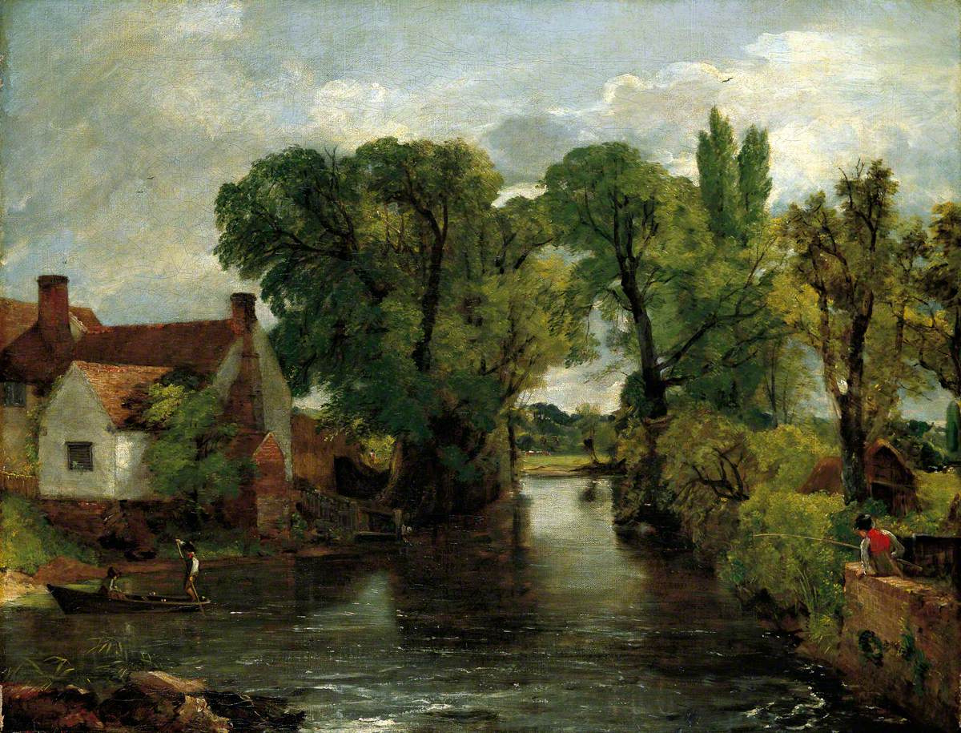
The Mill Stream, about 1814
John Constable (1776–1837)
Colchester and Ipswich Museums Service: Ipswich Borough Council Collection
Oil on canvas
H 18.7 x W 24.4 cm

Slide 6
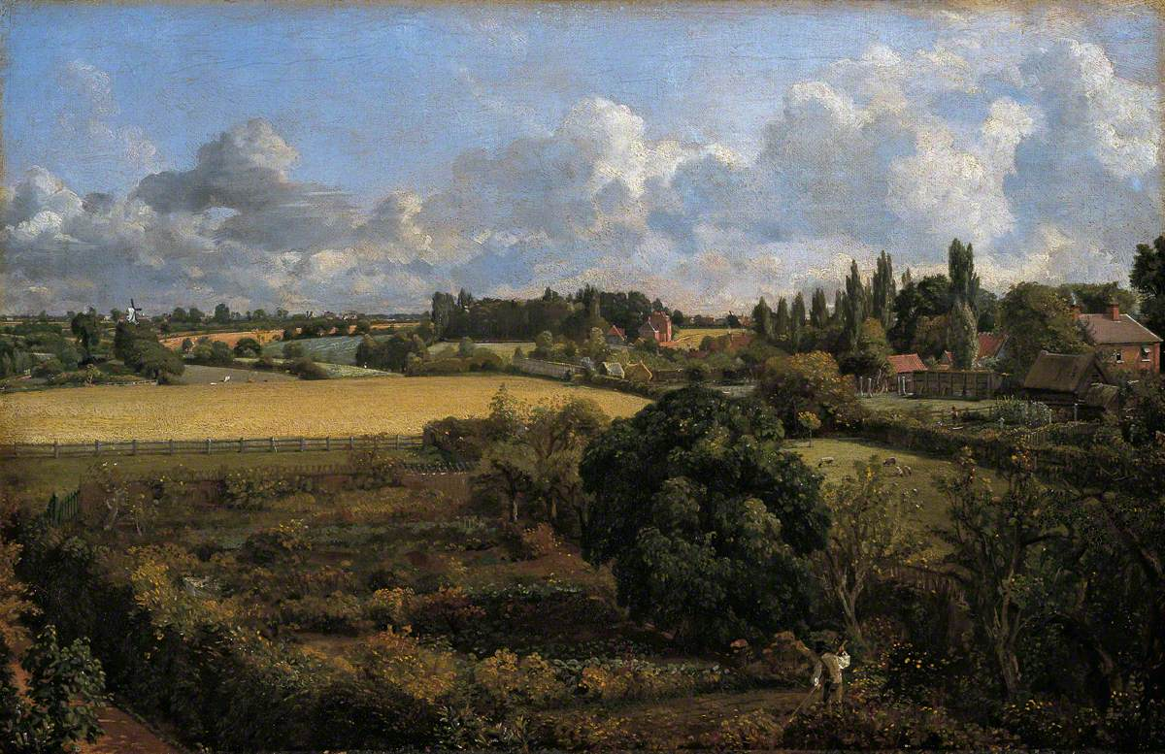
Golding Constable's Kitchen Garden, July 1815
John Constable (1776–1837)
Colchester and Ipswich Museums Service: Ipswich Borough Council Collection
Oil on canvas
H 33 x W 50.8cm

Slide 7
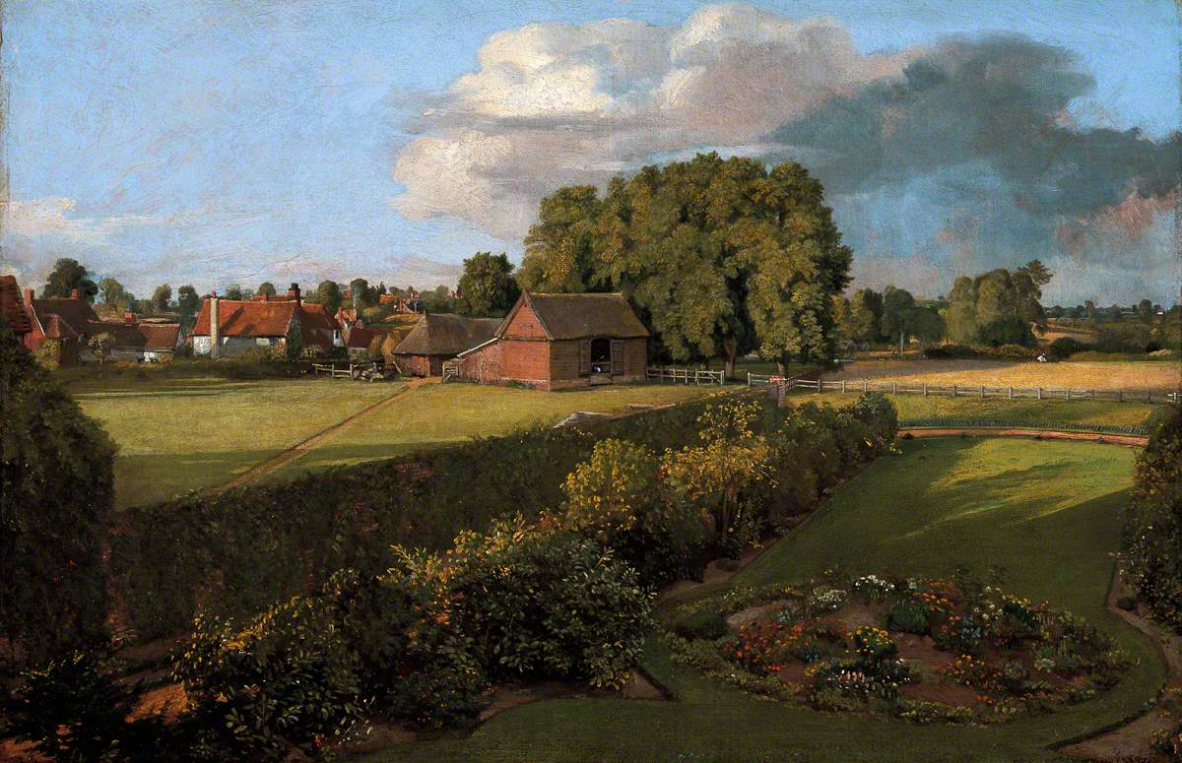
Ann Constable's Flower Garden, August 1815
John Constable (1776–1837)
Colchester and Ipswich Museums Service: Ipswich Borough Council Collection
Oil on canvas
H 33 x W 50.8cm

Slide 8
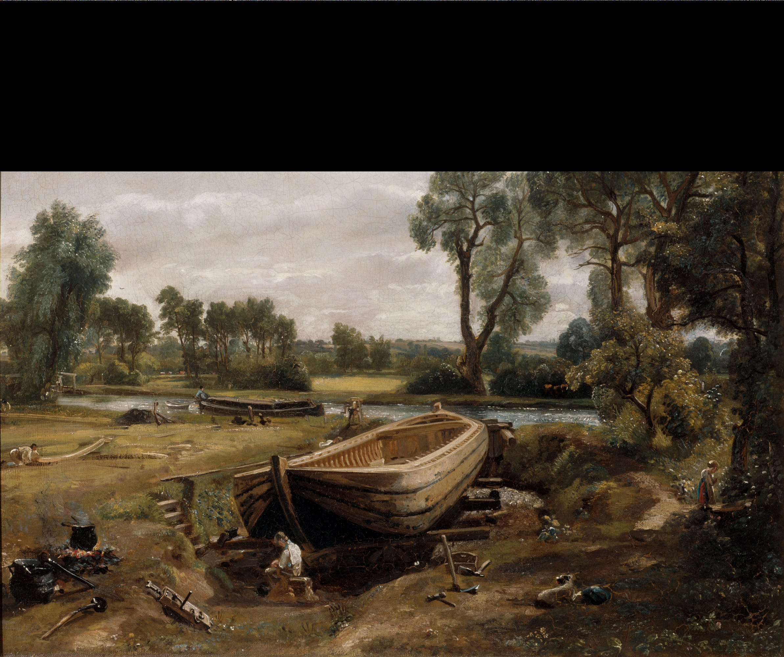
Boat Building Near Flatford Mill, 1814-1815
John Constable (1776–1837)
© Victoria and Albert Museum, London
Oil on canvas
H 50.8 x W 61.6 cm

Slide 9
Willy Lott’s House, 1816
John Constable (1776–1837)
Colchester and Ipswich Museums Service: Ipswich Borough Council Collection
Oil on canvas
H 19.4 x W 23.8 cm

Slide 10
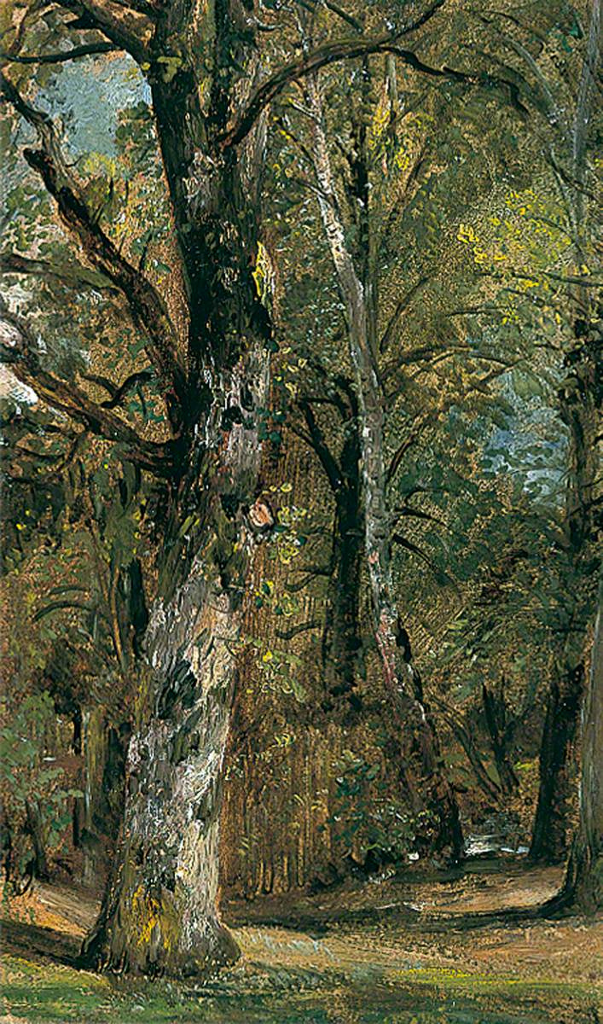
Avenue of Trees, about 1820
John Constable (1776–1837)
Colchester and Ipswich Museums Service: Ipswich Borough Council Collection
Oil on canvas
H 52 x W 36 cm

Slide 11
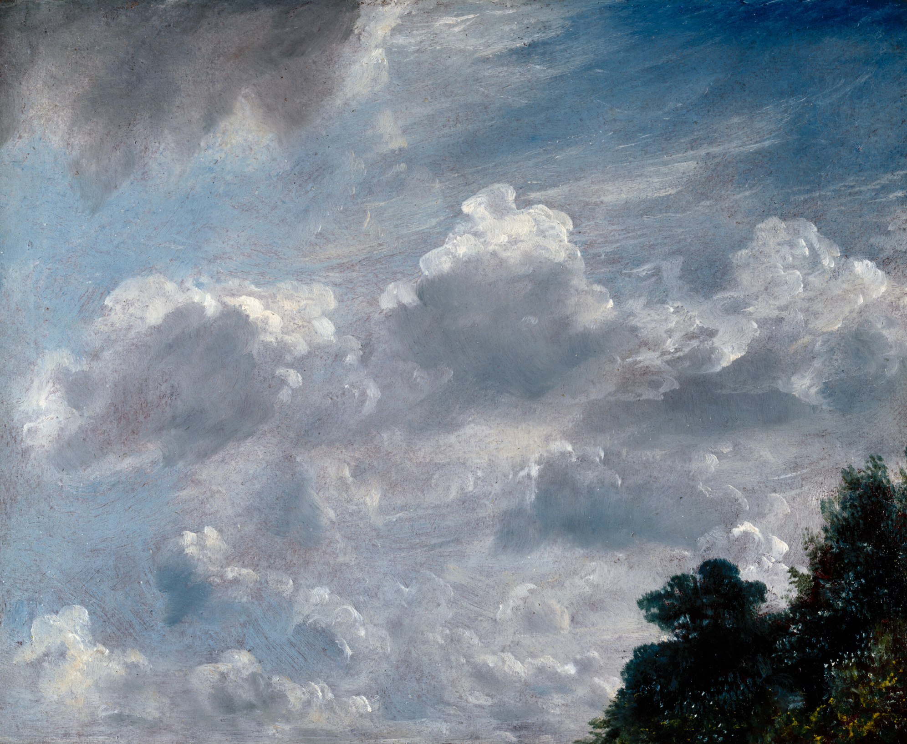
Cloud Study: Hampstead, Tree at Right, 11th September, 1821
John Constable (1776–1837)
© Photo: Royal Academy of Arts, London Photographer: John Hammond
Oil on paper laid on board, red ground
H 24.1 x W 29.9 cm

Slide 12
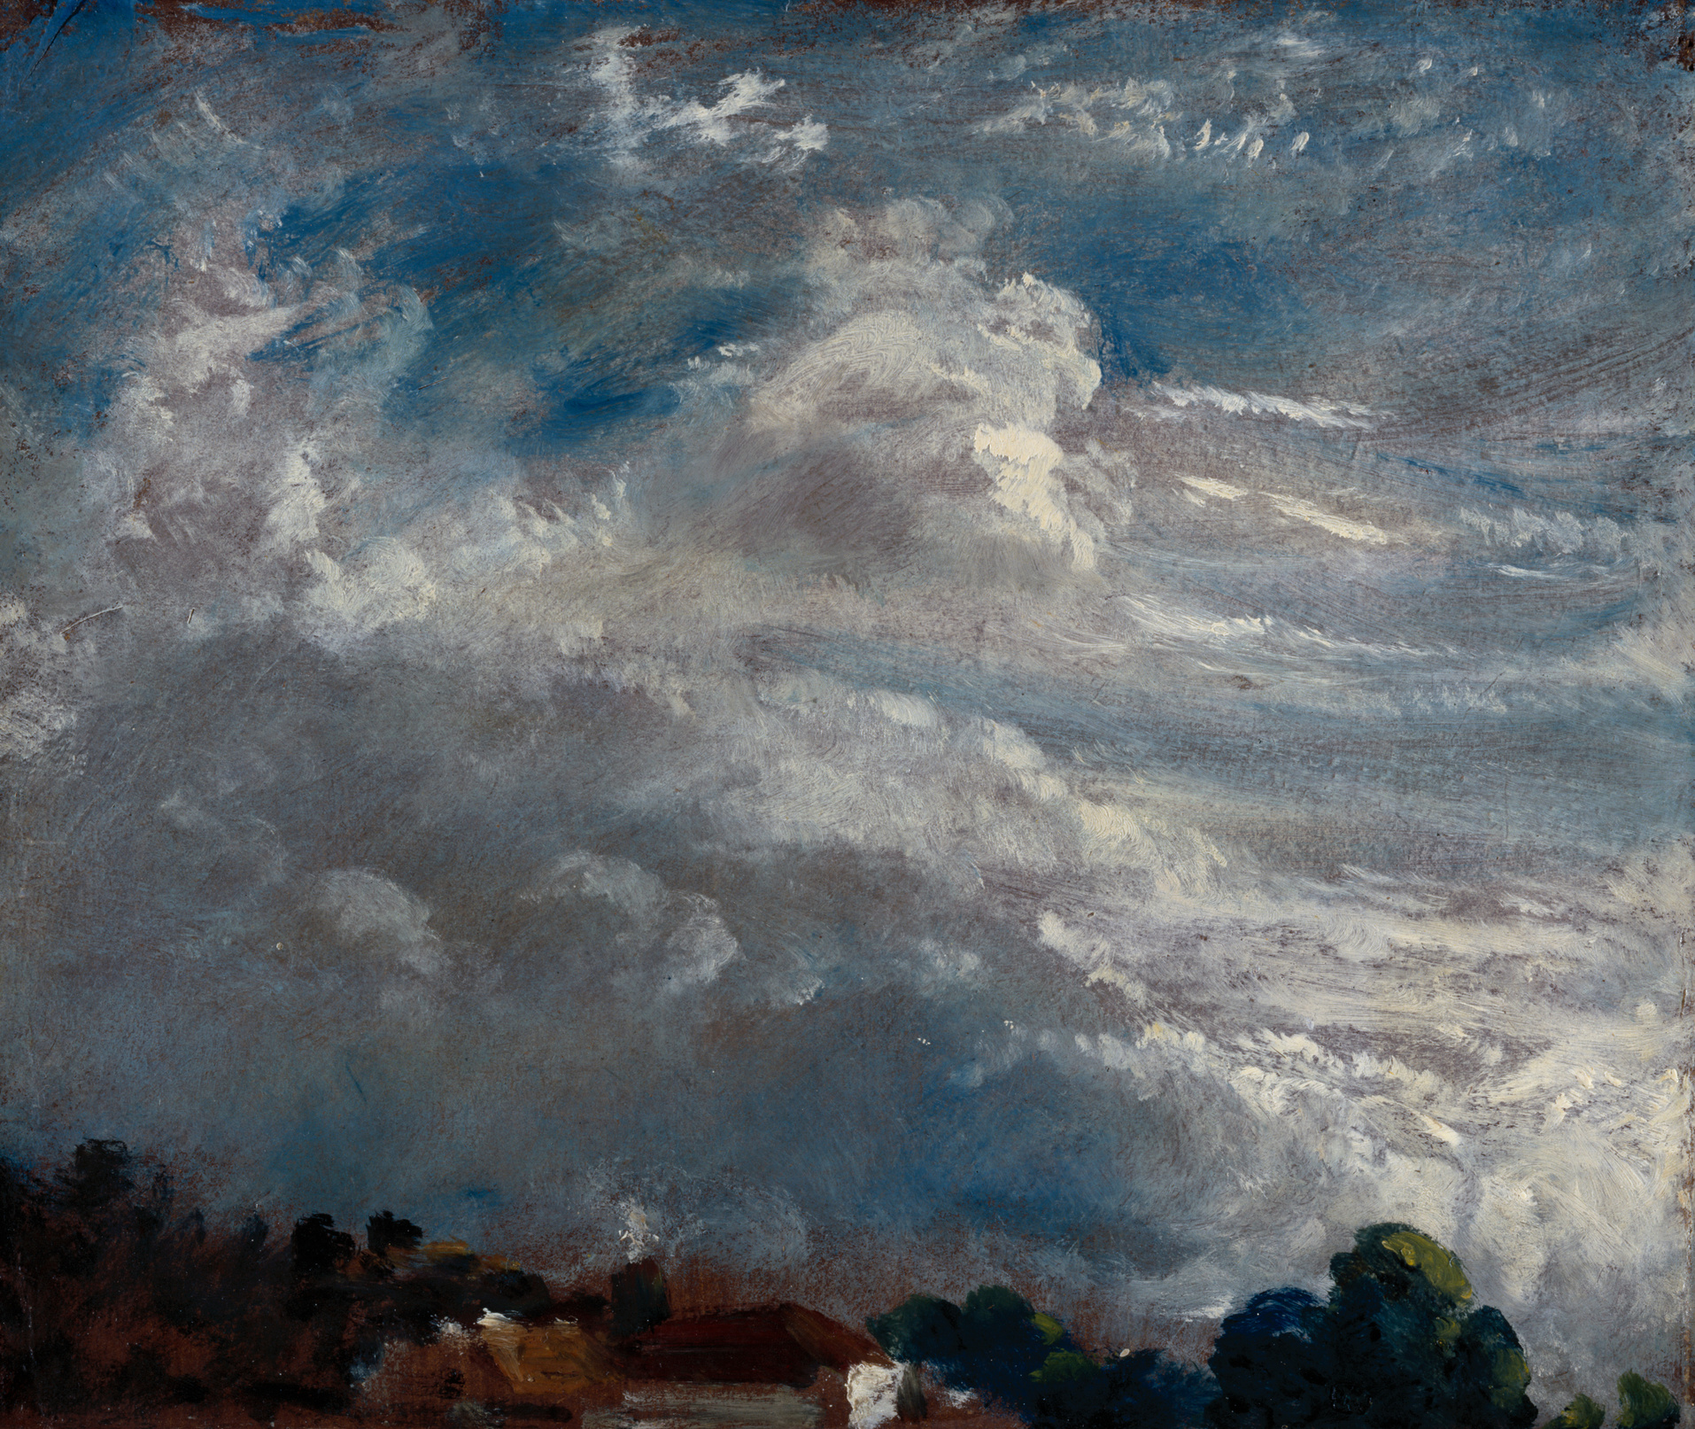
Cloud Study: Horizon of Trees,
27th September, 1821
John Constable (1776-1837)
© Photo: Royal Academy of Arts, London Photographer: John Hammond
Oil on paper laid on board, red ground
H 24.1 x W 29.9 cm

Slide 13
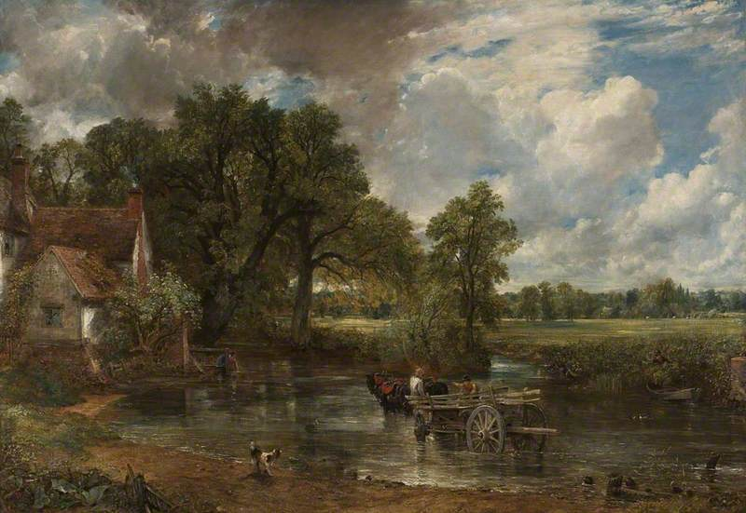
The Hay Wain, 1921
John Constable (1776–1837)
© The National Gallery, London
Oil on canvas
H 180 × W 238 cm

Slide 14
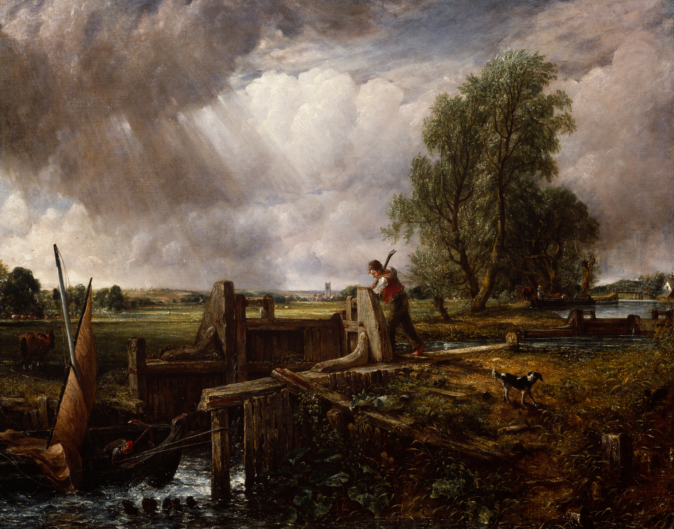
A Boat Passing a Lock, 1826
John Constable (1776–1837)
© Photo: Royal Academy of Arts, London
Photographer: John Hammond
Oil on canvas
H 180 × W 238 cm

Slide 15
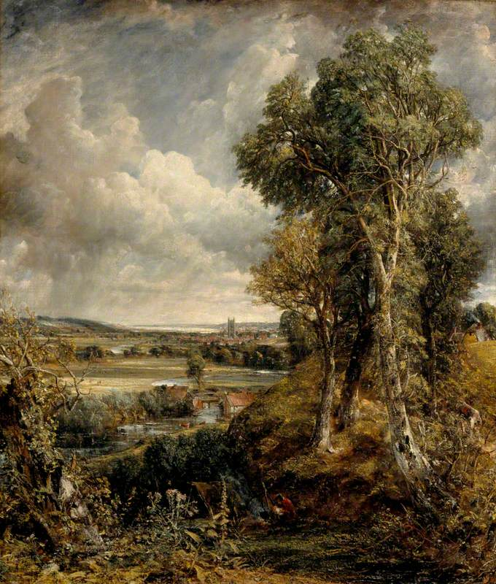
Dedham Vale, 1828
John Constable (1776–1837)
National Galleries of Scotland
Purchased with the aid of The Cowan Smith Bequest and Art Fund, 1944
Oil on canvas
H 144.5 x W 122 cm

Slide 16
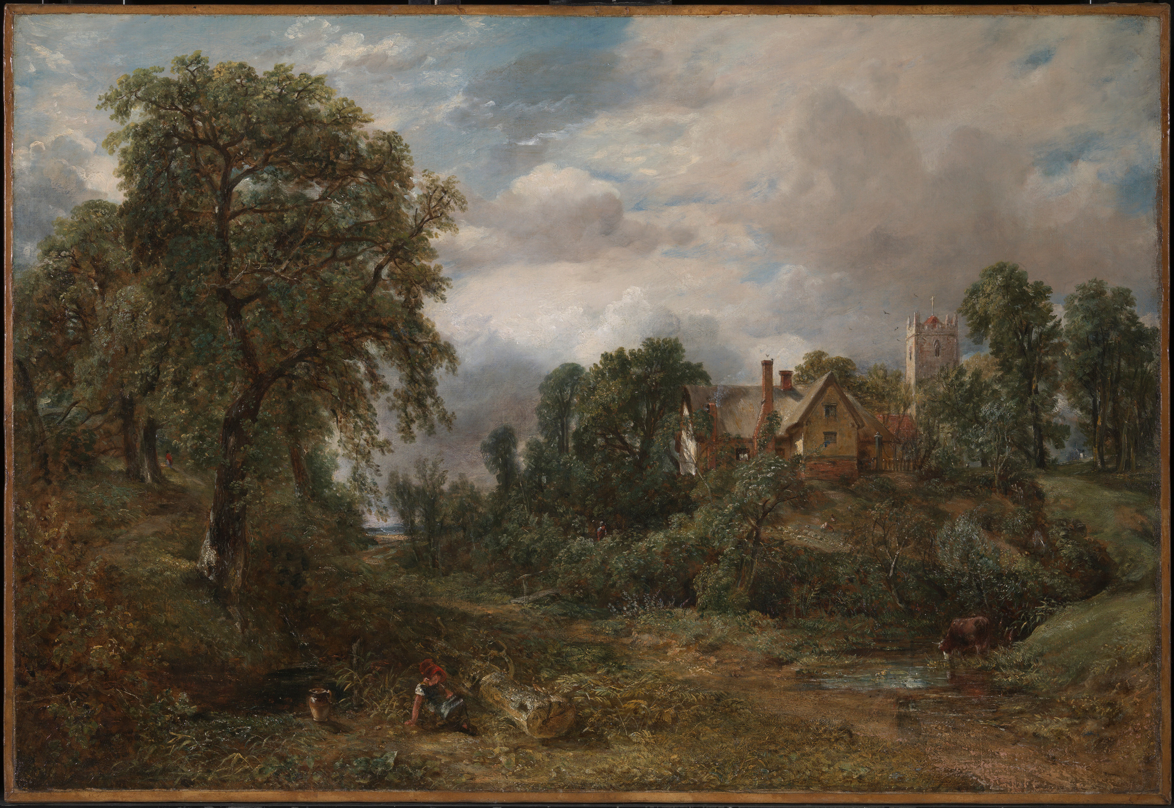
The Glebe Farm, about 1830, exhibited 1835
John Constable (1776–1837)
Tate
Bequeathed by Miss Isabel Constable as the gift of Maria Louisa, Isabel and Lionel Bicknell Constable 1888
Photo: Tate
Oil on canvas
H 94 x W 124.5 cm

